Slide 1


Investigation of Vulnerabilities in Open RAN Implementations
Research Project – WS 22/23
Arnova Abdullah
Weekly meeting-05 (17.11.2022)

Slide 2
Previous Weeks Meeting Details
Week 1 Meeting (19.10.2022)
Basics about Radio Access Network (History, parts of RAN for 1G, 2G, 3G, 4G)
Basics about Open RAN (Distribution unit, central unit, user plane, control plane, interfaces, front haul, mid haul, backhaul)
Open RAN risk analysis (Stakeholders of attackers-User, external attacker, cloud operator**, RAN operator**)
Week 2 Meeting (26.10.2022)
Installation of Kali Linux and Metasploitable
Atomic Red Team GitHub repository download
Research other open-source attack tools
Week 3 Meeting (02.11.2022)
Penetration testing using Kali Linux
Try Atomic tests by invoke-atomic
Get used to commands used for running a test
Research details about one of the attack tools - Infection Monkey
Read research papers on the risk of 5G open RAN
Week 4 Meeting (09.11.2022)
Finding the most relatable attacks from the MITRE ATTACK list (On going)
CyberOps course ongoing
Research paper by MOU

Slide 3
Week 5 Meeting (17.11.2022 - 10:00am)
Install Infection monkey
Download with filling up form from Akamai website
Install according to installation procedure
Get used to all the features and Gui
Compare Atomic Red Team and Infection Monkey
Start learning Docker container
https://developer.cisco.com/learning/tracks/containers/
https://learning.oreilly.com/videos/docker-fundamentals-for/9781803237428/9781803237428-video1_1/

Slide 4
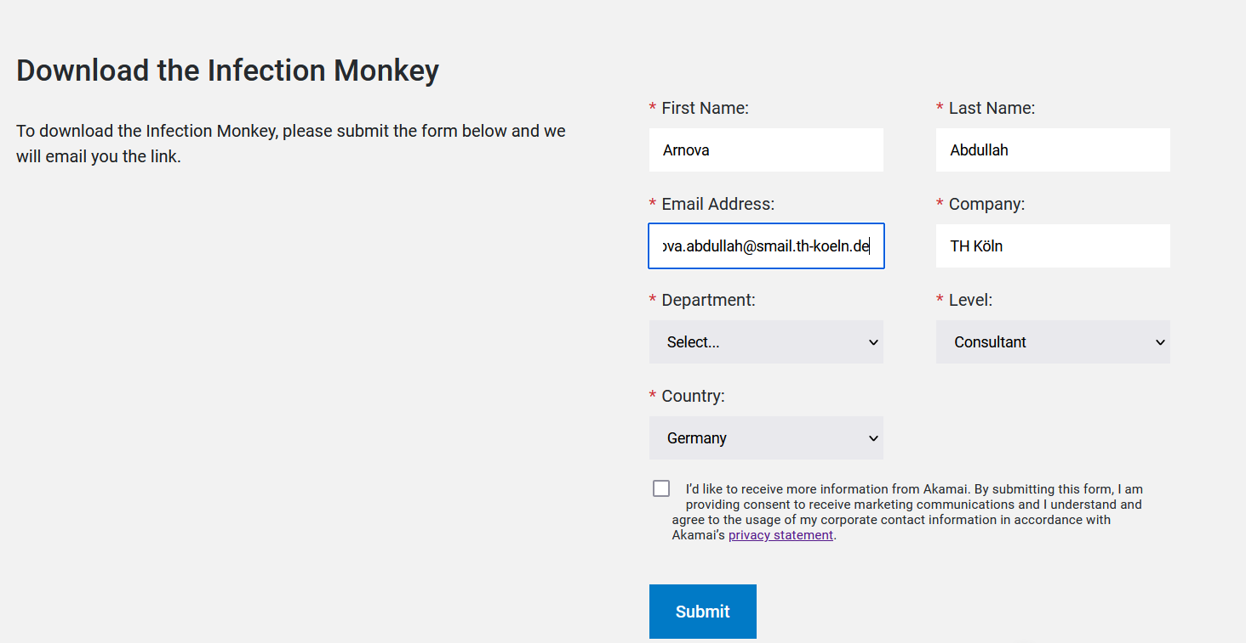
Install Infection monkey

Slide 5
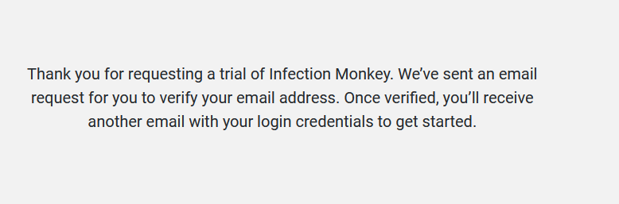
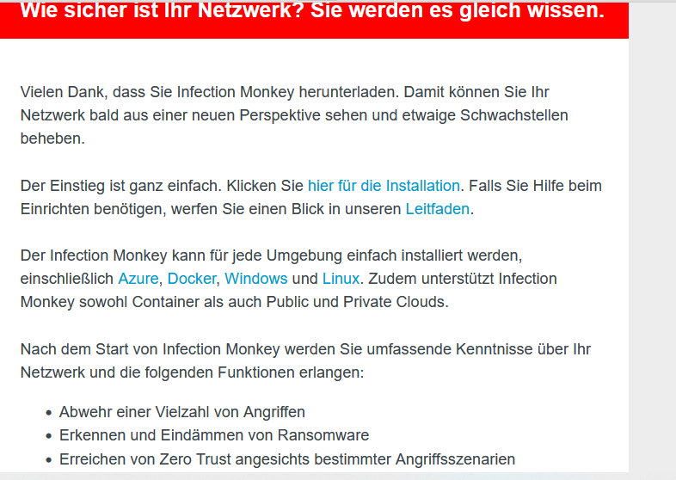
Install Infection monkey

Slide 6
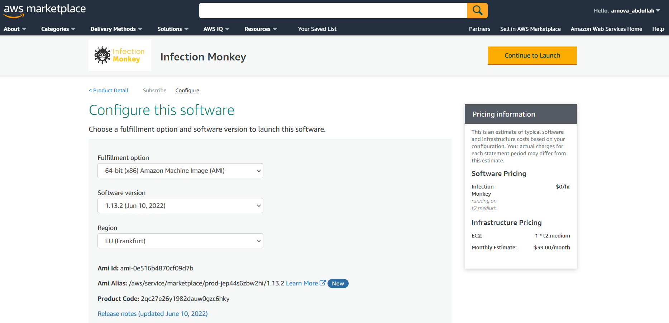
Install Infection monkey

Slide 7
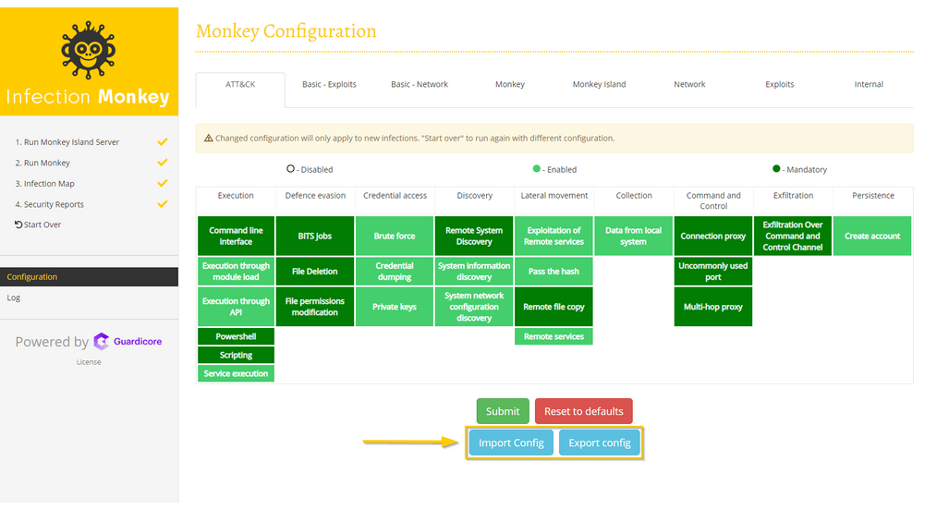
Install Infection monkey User GUI from internet

Slide 8
Start Learning Docker (Until chap-2)
O Reilly docker tutorial:
https://learning.oreilly.com/videos/docker-fundamentals-for/9781803237428/9781803237428-video3_2/

Slide 9
Discussion on Meeting
https://openaicellular.github.io/oaic/index.html
IT forensic: How to investigate an attack that already happened
This link is for proactive connection: When there is an ongoing active connection and there is an anomaly, then that is assumed to be an attack. Here are some attacks in the physical link. But our focus is after the connection is established, then apply some attacks and test the vulnerabilities of the system. Not in an active connection.

Slide 10
Next Steps (Week 6) (Until 23.11.2022)
IT security lab 2 complete
Kali Linux penetration testing experience
FTP backdoor
Unreal IRC Backdoor
Ingreslock Backdoor
distccd Backdoor
Samba Backdoor
Weak passwords
Attacks against databases
Vulnerable web services
Continue to learn docker (from Chapter 3 - Containers and images)

